Slide 1
Preventing victimization - I
Some tips and tricks to reduce the chances of different forms of victimization

Slide 2
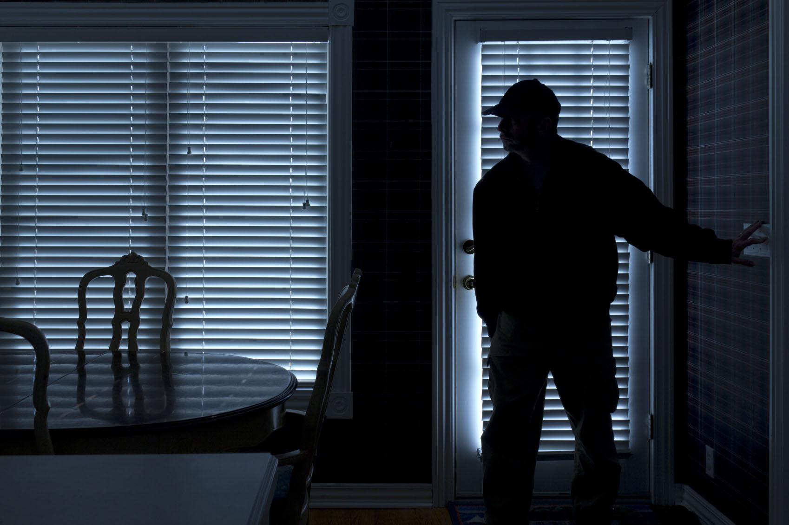
Burglary

Slide 3
Definition
Burglary is the crime that occurs when an offender breaks into and enters a home, place of business or other building or structure for the purpose of committing a criminal offence. Typical offences associated with burglary include: theft, robbery and sexual assault.
In Canada, the Criminal Code provisions for burglary have been replaced by the offence of ‘break and enter.’ However, the term ‘burglary’ remains in use in jurisdictions in the U.S. and elsewhere.

Slide 4
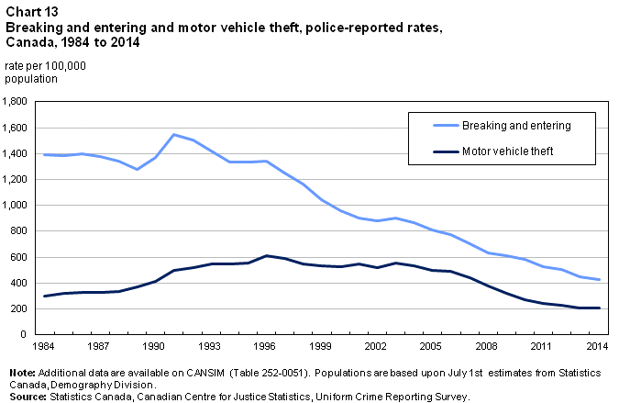
Stats and facts:
Because ‘break and enter’ (‘B and E’) is most commonly associated with property theft, it is treated as a property crime in Canadian criminal justice statistics.
The most recent Canadian crime statistics (2015) reveal that police reported ‘B and Es’ (151,900 break-ins in 2014) accounted for 14% of all property-related offences. Since 2003, rates of B and E have been declining in Canada.

Slide 5
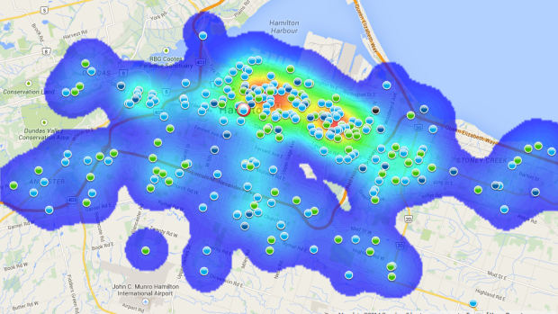
What do we know about burglary?

Slide 6
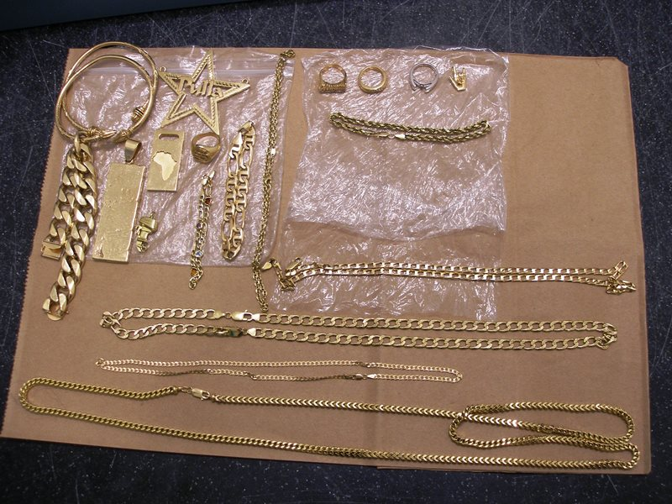
Research on burglary has focused largely on 5 factors:
1. offender motives and types – perhaps not surprisingly, research into offender motives suggests that many offenders are driven by a desire for quick, easy cash in support of an already criminal lifestyle (usually associated with drugs and alcohol). Some researchers, notably Fox and Farrington (2012) have developed typologies of burglary offenders based on crime scene behaviour and demographic characteristics of offenders in solved cases.

Slide 7
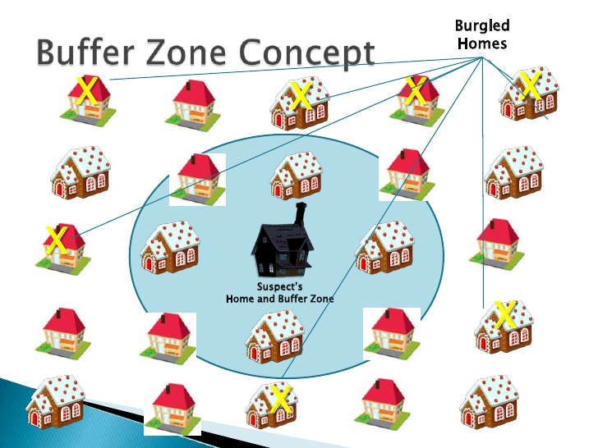
2. familiarity – offenders typically select targets within neighbourhoods they know, because increased familiarity with a space means they will better understand where there are more vulnerable and more protected spaces, places to hide and exit and entrance routes into the area, among others. As a result, most offenders do not travel very far to commit their offences (Brantingham and Brantingham 1981).

Slide 8
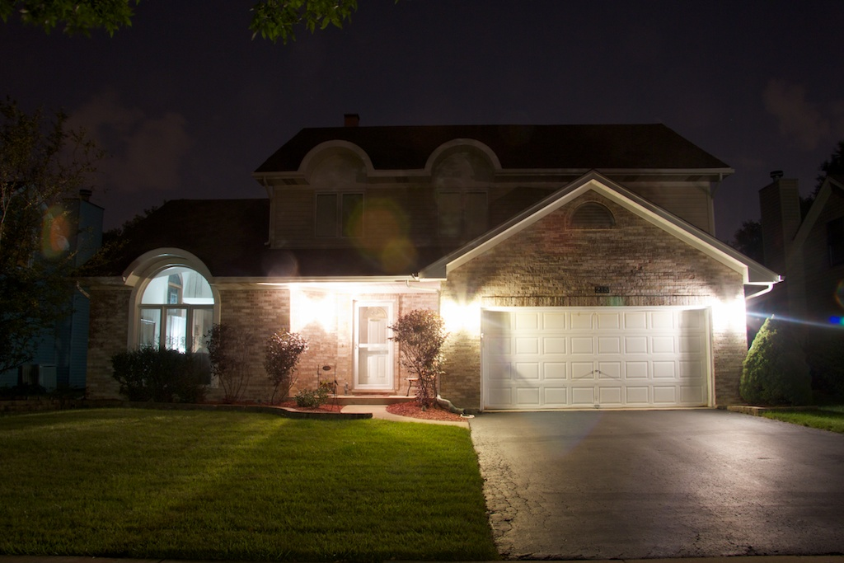
3. occupancy – with the exception of sexual burglaries and home invasions (breaking into someone’s house in order to rob them), most burglars prefer unoccupied targets. Before attempting to break in, burglars will check for signs that someone is home (lights, noises, parked cars in the drive way, human silhouettes).

Slide 9

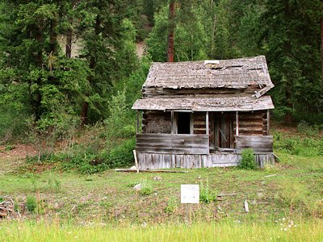
4. signs of potential rewards: since the motivation for most burglars is financial, an important aspect of target selection is the possibility of being able to steal items of high value. Thus, offenders look for signs that a potential target will yield financial rewards.

Slide 10
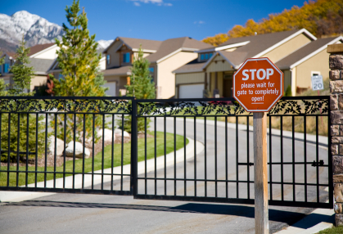
5. the built environment: often found in discussions of Crime Prevention Through Environment Design (CPTED), this is a term used to describe those features of an area that are designed and built by humans. In relation to burglary, the built environment typically refers to those features of a neighbourhood or community that can increase or decrease communal safety.
An excellent example of how a built environment can potentially deter burglary is the gated community, which controls access to the homes within through the use of deterrent fencing, guards, CCTV cameras and remote control access.

Slide 11
More on familiarity
repeat victimization – several studies suggest that once an address has been victimized, it can be further re-victimized multiple times. This is because it is easier for offenders to repeat a crime where they have already been successful than to identify a new target (Pease 1998).
In a study by Ericsson (1997), 76% of burglars interviewed stated they had gone back to previously targeted houses to re-burgle them after a period of time (during which the owners would likely purchase new items). Some offenders advised they had burgled the same house between 2 and 5 times.

Slide 12
Familiarity continued:
Not all homes or businesses are at equal risk of being re-victimized.
Homes in higher-income neighbourhoods are typically re-burgled less frequently.
One explanation is that, once victimized, home owners spend money installing and upgrading security features.
Another explanation is that burglary in affluent neighbourhoods typically requires some planning and travel, making repeats less likely, whereas burglary in lower-income neighbourhoods, where burglars likely live, can be more random and opportunistic (Bowers and Johnson 2005).

Slide 13
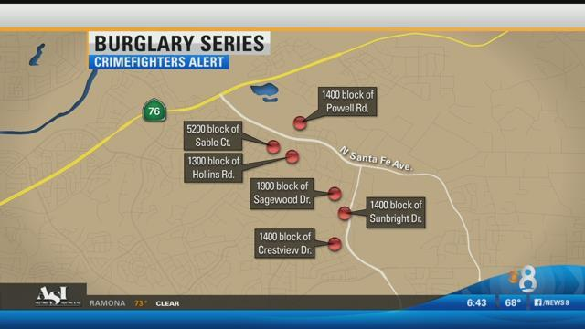
Familiarity continued:
near repeats – once a home or apartment in an area has been burglarized, nearby residences or structures are at increased risk of becoming victimized because it signals to the offender that this is a ‘safe’ neighbourhood within which to commit further offences. Once a home in a neighbourhood has been victimized, subsequent victims in the area are termed a ‘near repeat’ (Morgan 2000).

Slide 14
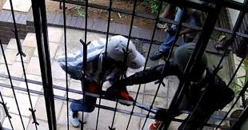
More on occupancy – day-time burglary
Daytime burglaries are often committed by younger, less experienced offenders, often in pairs and on foot. Ie. amateurs
While being on foot exposes them to increased risks of being seen, many select low-density, less secure homes with vegetation or other cover to reduce their visibility.
Daytime is also more opportune for avoiding
home owners; younger offenders are less willing to
risk encountering victims directly (Montoya et al. 2015).

Slide 15

More on occupancy – night-time burglary
Night-time burglaries are more frequently committed by older, more experienced offenders, working alone, and usually closer to home. Ie. professionals
Working at night increases the risk of encountering a victim, as does the fact they may select more heavily guarded structures (Coupe & Blake, 2006).

Slide 16

Crime prevention

Slide 17
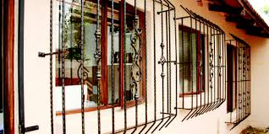
A key concept in burglary prevention:
target hardening – making a home or other structure less attractive by
decreasing the odds of successful entry and/or
increasing the risk of the perpetrator getting caught.

Slide 18
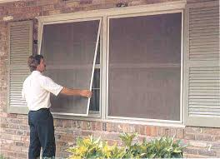
What works to deter day-time burglaries?
In a study by Montoya and others (2015), houses were less likely to be victimized by day-time offenders when they:
Had a front yard or front garden
Were attached or semi-detached dwellings (they were more likely to be victimized if on a corner lot).
Were located within a stable neighbourhood
Were close to commercial establishments
Had window screening

Slide 19

What works to deter night-time burglaries?
Houses were less likely to be victimized by night-time offenders when:
they were undetached
they had window screening
there were signs of a dog present
there was visibility into the back yard or garden

Slide 20
Target hardening & displacement effects
Target hardening efforts can produce a displacement effect by making nearby homes without security measures more attractive to offenders.
Research by Bowers and Johnson (2005) found that near-repeats were more likely in wealthier neighbourhoods, where the original victim could afford to install security measures (by way of contrast, repeat burglaries of the same dwelling more common in low income housing).

Slide 21

*all done!*

